Slide 1
Joseph

Slide 2
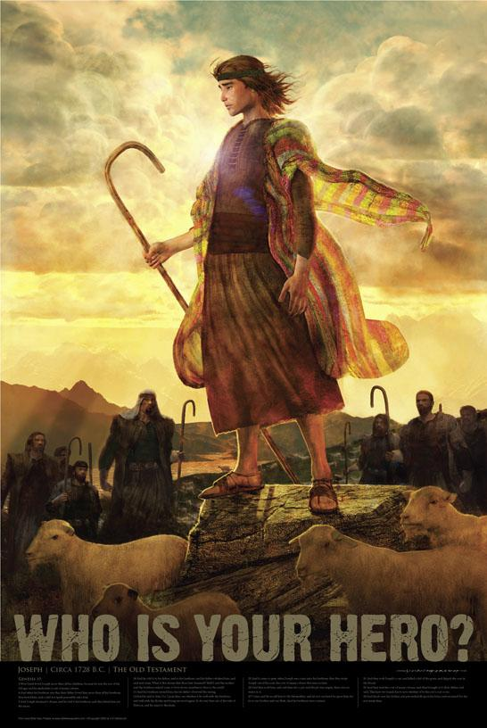

Slide 3
His Genetics
Father a former deceiver.
Grandfather (Isaac) unwisely favored an unworthy son.
Mother took the household gods: Genesis 31:34

Slide 4
His Extended Family
A division among Grandparents.
His uncle vowed to kill his father.
Uncle sold his birthright.
His Grandfather (Laban) was a swindler.
Raised in a home with one mother and three step mothers.
Rivalry between the wives.

Slide 5
His brothers had murdered some innocent people: Genesis 34:25
Immorality in the family: Genesis 35:22
His brothers were bad influences
Genesis 37:2
Hated by his brothers: 37:4

Slide 6
Did not look to genetics.
Did not look to environment.
Looked to God: Genesis 39:9

Slide 7
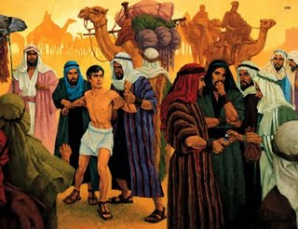

Slide 8
The Language of Why?
“Why did my brothers sell me?”
“Why did Popithars wife pick on me?”
“Why did she lie?”
“Why has God allowed this to happen to me?”
“Why hasn’t my father found me yet?”

Slide 9
“Circumstances are against me”
“I can’t get a break”
“It is vain to serve the Lord”
“The wrong people are being rewarded or believed”

Slide 10
The Language of Faith
God has not forsaken me: Heb. 13:5
God is my helper: 13:6
I can handle this: 1 Corinthians 10:13
I am loved by God. I am blessed.
I can do all things through Christ: Phil. 4:13
All things are possible with God.

Slide 11
This will make me stronger: James 1:2-4
God is for us: Romans 8:31
God says I can change: 2 Peter 3:9
With God I can turn any event into a victory: 2 Corinthians 2:14

Slide 12
“The Lord Was With”
In Egypt: Genesis 39:2
In Jail: Genesis 39:21,23
God is with us in any situation.

Slide 14
Bringing a Blessing
39:3-5
39:21-23
Does not have to be mysterious or miraculous.
The result of honesty, diligence, a good attitude, working with our heart in it.
A Self-Starter.

Slide 15
Proverbs 10:4 “But the hand of the diligent makes rich”
Proverbs 12:24 “The hand of the diligent will rule”

Slide 16
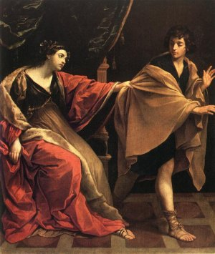

Slide 17
The Attack
At a time of prosperity: 39:6-7
Through His strengths, assets: 39:6
Tempted to misuse our gifts/talents.
“I deserve this”
Away from home, no one knows his faith or his family.

Slide 18
The Real Me
How I act when no one is looking.
How I act when away from home, in another city, surrounded by strangers.
How I act when I am alone.
How I act in private.

Slide 19
The brazen move: 39:7
The refusal: 39:8
The reasoning: He has given me everything except you. 39:8
He did not focus on the one thing he did not have, but instead of all the blessings he did have.

Slide 20
The Language of Doubt
“I going to miss out”
“I can’t be happy unless….”
“If only I had….”
“I am deprived”

Slide 21
The Language of Faith
“I am currently blessed”
“I am currently happy”
“I have everything I need”
“My cup overflows”
Luke 6:38

Slide 22
The attack continues.
Reopening the closed question: 39:10
The surprise attack: 39:11.

Slide 23
The Language of Doubt
“After all that I have been through---I deserve this”
“She is lonely---I am lonely”
“No one will find out”
“Let’s talk about it”
“Let me think about it”
“God would not want me to be unhappy”

Slide 24
The Language of Faith
“It is evil”
“It is sin against a loving God”
“Nothing can ever make this right”.
“This is wrong all the time in any circumstance”
“My loyalty is to God”.

Slide 25
All Lost or Won
In a moment.
Too late to “think about it”
Pause, be indecisive—disaster
Proverbs 7:21-22 “Suddenly”
“Flee”!
Have your mind made up beforehand.

Slide 26
Faith is prepared for persecution.
Faith does not demand an immediate reward for doing the right thing.
Faith is prepared for the long haul.

Slide 27
No time spent in self-pity.
Still acting like a godly person.
The same person in good and bad times.
Circumstances do not justify bad attitudes.
“Been under a lot of stress lately”
“Had a bad day?”

Slide 28
“Don’t like your boss?”
“The commute is a bear?”
Did we forget we have our freedom?
Did we forget that we get to go home?

Slide 29
Another Opportunity
Will he be gun-shy?
“Didn’t go well the last time”
“I learned my lesson—I just keep to myself”
“That’s what you get for working hard”

Slide 30
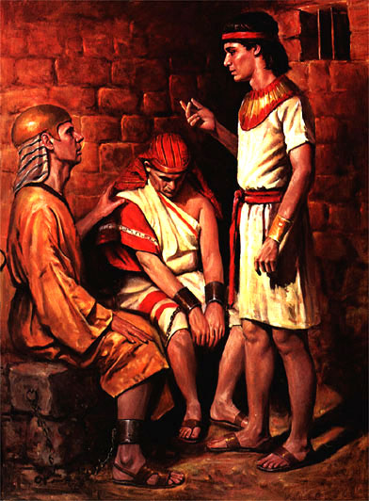

Slide 31
Yet, Joseph was not the only person in trouble: 40:2
He “observed them”: 40:6
We will miss opportunities if we are focused on our problems.
Asked a question: 40:7

Slide 32
The Language of Doubt
“Keep to yourself”
“Mind your own business”
“Do not get involved”
“Leave people alone”
“Keep God out of the conversation”
“Play it safe”

Slide 33
“I only have time for me”
“I am overwhelmed”
“I have nothing to give others”
“I have nothing to offer”
“I am barely holding it together”

Slide 34
The Language of Faith
“These are my neighbors”
“I know what it is like to be dejected”
“God at the center of the conversation”
Give God the glory: 40:8
“I have resources”
“I have plenty to give”
2 Corinthians 12:15

Slide 36
The Setbacks
Mother died.
Hated and betrayed by brothers.
Falsely accused.
Forgotten: 40:14,23

Slide 37
The Language of Doubt
“The story ends here—at this moment”
“No more chapters to be written”
“Nothing is going to change for the better”
“The situation is hopeless”

Slide 38
The Language of Faith
“Watch out world—when things seem hopeless—God shows up”
Israel in Bondage
On the edge of the Red Sea
Abraham and Sarah and no offspring
Gideon
David and Goliath
Esther

Slide 39
“Many chapters are yet to be written—and I will have a role to play in writing them”
How do you want the story to end?
The story of your life?
The story of your marriage?
The story of your faith?

Slide 42
“He finished strong”
2 Timothy 4:7-8

Slide 45
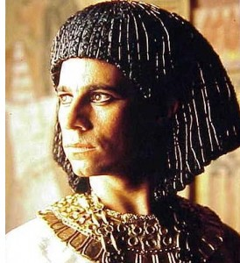

Slide 46
When Prosperity Arrived
At 30: 41:46
Still diligent and honest: 41:49
Still faithful: 41:51
Still gave God the glory.
Still had a sensitive heart: 43:30

Slide 47
The Language of Doubt
“I am bitter about the past”
“I lost the best years of my life”
“Nothing good came from that…”
“That was wasted time”
“I will remain angry about that until I die”

Slide 48
The Language of Faith
“I see the good that happened”
“I see my own personal growth”
“I see how it strengthened my faith”
Genesis 45:5,7
Genesis 50:20

