Slide 1
Start Young

Slide 4
For Parents
“Train up a child in the way he should go” (Proverbs 22:6)
“Discipline your son while there is hope” (Proverbs 19:18)
“Foolishness is bound up in the heart of a child, the rod of discipline will remove it far from them” (Proverbs 22:15)

Slide 5
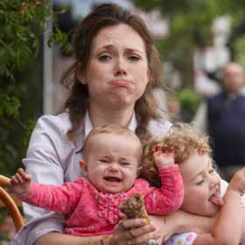

Slide 7
Challenges
“I am busy right now”
“I am overwhelmed right now”
“They are just kids”
“They will naturally grow out of it”
“We still have plenty of time”

Slide 8
“They really won’t become set in their ways until years later”

Slide 9
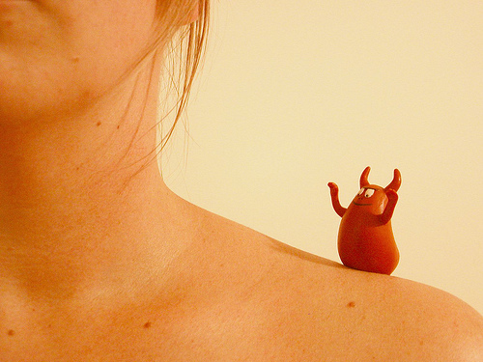

Slide 10
The Devil Starts Young
To get into their thoughts.
To use their foolishness against them.
To derail them.

Slide 11
Fast Facts
10 is the new 15?
Between the ages of 3 and 17, today’s child will have spent 3-5 years of their life in front a of computer and viewing things online.
By the time that kids are 12 they are describing themselves as flirtatious, sexy, trendy and cool.

Slide 12
Ages 8-12
More drug use.
More sexual contact and behavior.
More suicides.
More eating disorders.

Slide 13
They view anything on the Internet as being valid.
Many kids 8-12 on their own. Shopping for their own clothes, making their own lunches, often eating dinner out of a box all alone.

Slide 14
Ironically, kids are growing up too fast these days and then not fast enough. Our culture pushes children to act and look like adults at younger and younger ages, and then tells them to slow down and stay in adolescence as long as they want.

Slide 15
“The men of the city, the men of Sodom, surrounded the house, both young and old, all the people from every quarter” (Genesis 19:4)

Slide 16
“The wicked are estranged from the womb; these who speak lies go astray from birth” (Psalm 58:3)

Slide 17
Does not mean one is born astray.
But it does mean that sinful thoughts and habits can be established from an early age.
The course for rebellion can be chosen early on.

Slide 18
Toward other men: Venom, trash talk.
Toward God: A deaf ear.

Slide 19
“So remove, vexation from your heart” (Ecclesiastes 11:10)
Vexation is already there to remove.
“Remember also your Creator in the days of your youth” (Ecclesiastes 12:1).

Slide 21
Vexation Stages
13-15
Now it is 8-12—or younger.
Can’t drive yet.
Hard time finding a job.
After a breakup.
When you are the newbie.

Slide 22
18-21
I am in college—I am now more intelligent than my parents.
With an education and a career….
I don’t need marriage.
I don’t need God.

Slide 23
Observe.
It is your job to remember God.
It is your job to work on your mental attitude.
It is your job to make sure you have the right perspective.

Slide 24
Danger Areas

Slide 26
How You View Parents
With contempt?
Making fun of them?
Embarrassed to be with them?
“The eye that mocks a father, and scorns a mother, the ravens of the valley will pick it out, and the young eagles will eat it” (Proverbs 30:17)

Slide 27
Honor
Ephesians 6:1-2
Exodus 20:12
Romans 1:30
The predictable result of a conscious decision to live for self.

Slide 28
Do I Really See?
The value of their correction: Proverbs 13:1
The value their input and advice?
What they have accomplished?
The many years of happily married life to the same person.
Working day in and day out.
Consistently providing for the family.

Slide 29
Putting the needs of the family ahead of their own.
Keeping a clean and organized home.
Having many real friends.
Being able to be happy in all circumstances.
Being able to wait.

Slide 30
My parents have an established track-record—verses other voices.
A record of wise decisions.
Keeping their commitments.
Doing what they preach.
Being consistent for many years.
They have serious credibility.

Slide 31
Attempts to Derail Us
The habit of blaming others for our failures.
The habit of making excuses.
The habit of laziness.
The habit of procrastination.
The habit of playing before work.

Slide 32
For Adults
Any attitudes that we have had for way too long that we adopted when young—and are not true?

Slide 33
For Kids
Do not give him a foothold in your life.

Slide 34
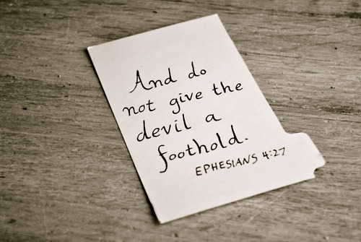

Slide 35
Footholds
You will not be popular if you seriously pray or read your Bible.
You are supposed to complain about going to worship.
You will not be popular if you talk and are involved in Bible Class.

Slide 36
You are supposed to be embarrassed to be seen with your parents.
Do not volunteer.
Do not lead.
Do not talk about your faith.

Slide 37
Hold back—let someone else do the hard stuff.
Whine and sulk to get your way.
If you don’t get your way—punish people by having a poor attitude.
Only listen to your own generation.
1 Kings 12:10, 13

Slide 38
Desire independence from God and responsibility.
Desire to do less.
Desire lower expectations.

Slide 39
Practical Help
Take control of your head.
Philippians 4:8
Actually say to yourself:
“Thinking about this isn’t going to do me any good”
“This thought will only lead to unhappiness”
“That idea is not true”

Slide 40
Really Being Grown Up
Not so much about fashion.
About attitude and behavior.

Slide 41
Hard worker
Grateful
Happy
Content
Diligent
Unselfish

Slide 42
Knowledgeable of the Bible.
Involved in the church.
Active in helping.
Helping at home.
Accepting responsibility.
Encouraging others.

