Slide 3
Plurality
Acts 14:23
Acts 15:2
Acts 20:17
Acts 21:18
Titus 1:5

Slide 4
James 5:14
1 Peter 5:1,5

Slide 5
We never find a congregation ruled by one elder.
God’s wisdom.
We have all seen what happens when one person has all the power.

Slide 6
It would be unfair to put all entire weight of watching for the souls of an entire flock on the shoulders of just one man.

Slide 8
Without elders we cannot have deacons.
No example of a congregation with deacons and no leadership.
Without elders—the deacons would have to assume elder responsibilities.

Slide 9
Without Elders
A congregation can exist.
Acts 14:23
Titus 1:5
Yet there is something incomplete.

Slide 10
Reporting to the elders: Acts 11:30
Acts 21:18

Slide 11
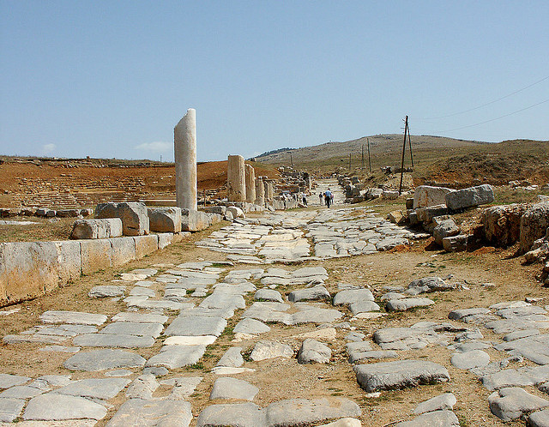

Slide 12
No mention of elders: Acts 11:26; 13:1
Acts 11:27
Acts 15:2 “the brethren determined”
Acts 15:3 “by the church”

Slide 13
In light of male headship….
Women not exercising authority or teaching men: 1 Timothy 2:12
The group that would make decisions, “the brethren” would be the men of the congregation.

Slide 14
Importance of Elders
Elders and apostles.
Acts 15:4
Acts 15:22
Acts 16:4
Acts 4:35; Acts 11:30

Slide 15
Limited Rule
Specifically told to govern the congregation of which they are members.
The reason why elders were appointed in every church.
Acts 14:23
Why the Ephesians elders guarded one flock: Acts 20:28

Slide 16
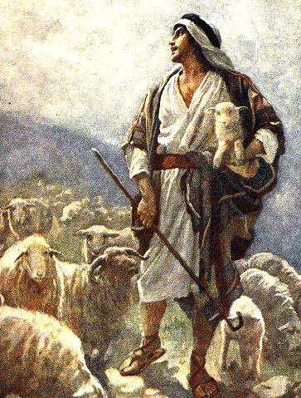

Slide 17
1 Peter 5:2
“Shepherd the flock of God among you”
“The flock in your care”
Indicating there were flocks not in their care.
There is no way that one eldership can shepherd people they do not know.

Slide 18
“There were pastors of the New Testament congregations, and each congregation had several who were chosen and called by the congregation” (Lenski, 1 Peter).

Slide 19
“Must Be”
Titus 1:7
1 Timothy 3:2
Indicates ongoing qualifications.
I am hesitant to use my human wisdom and declare which qualifications are continually needed and which are not.

Slide 20
I don’t want to make two lists.
One list of qualifications if you are being considered for the eldership.
One list if you are already an elder.
The lists should be the same.

Slide 21
Details—Do They Matter?
Numbers 20:8
Numbers 20:11
Numbers 20:12

Slide 22
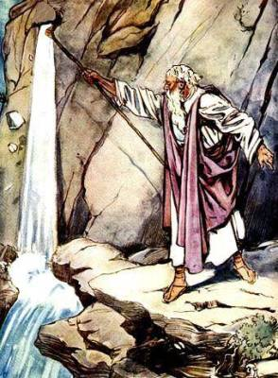

Slide 23
“Treat Me as Holy”
In important matters the details always matter.
We recognize and expect that.

Slide 25
Matthew 7:22-23
What was the “lawlessness?”
Clearly, the details mattered to Jesus.
He takes His law seriously.

Slide 26
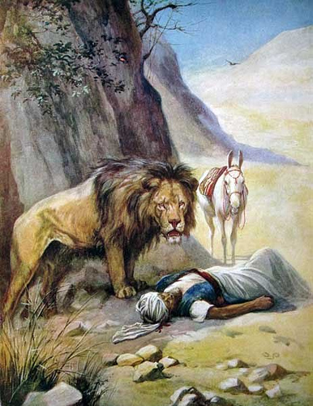

Slide 27
1 Kings 13
1 Kings 13:7-10
1 Kings 13:15-19
1 Kings 13:20-24

Slide 28
“But he lied to me”
“But he is far more unfaithful than I am”
“He should die instead of me”

Slide 29
“Trust me”
“God won’t mind”
“Maybe we are taking the details too seriously”
“God doesn’t care about that”
“We had good intentions”

Slide 30
Even the unfaithful can see disobedience: 13:26
Many might have expected something bad to happen to the old prophet.

